Slide 1
Alice’s Adventures in Wonderland
BA280 Winter 2021
Sandra Gee

Slide 2
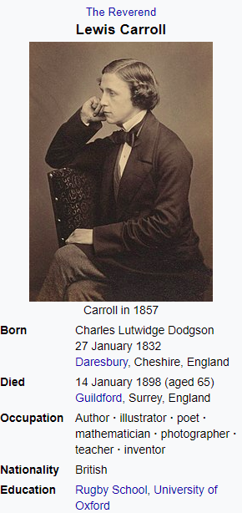
Purpose: Words
The Author
“He was noted for his facility with word play, logic, and fantasy.”

Slide 3
Our Fascination With Alice
Franchise Works
Films | Television Series
Alice in Wonderland 1951 | Adventures in Wonderland 1992-1995
Alice in Wonderland 2010 (live action)
Alice Through the Looking Glass 2016 | Once Upon a Time in Wonderland 2013-2014
Also:
1 Play, 3 Video Games, 4 soundtracks or musical scores, 3 theme parks

Slide 4
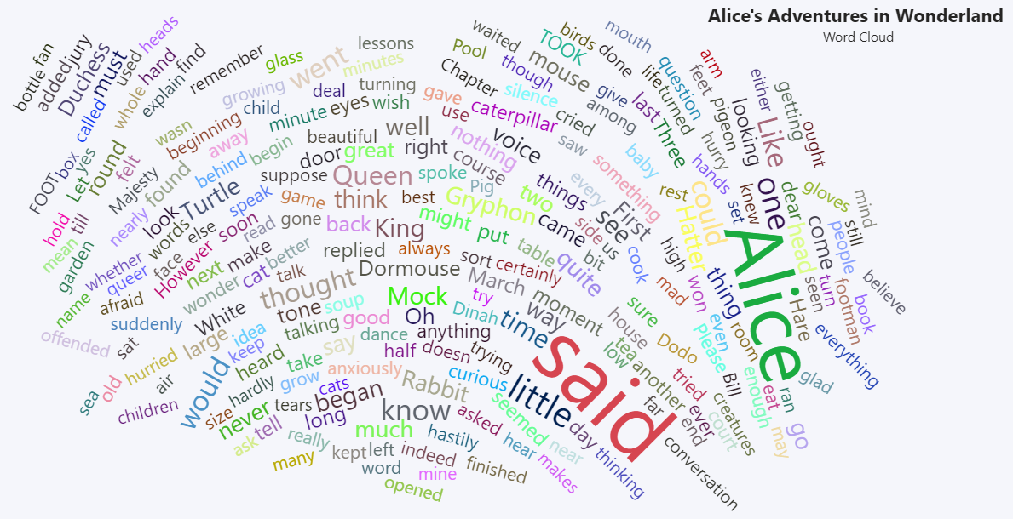
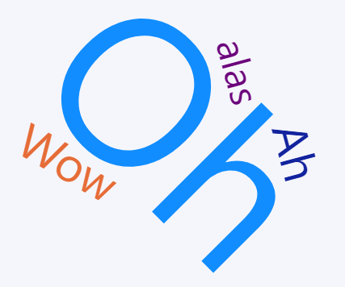

Slide 5
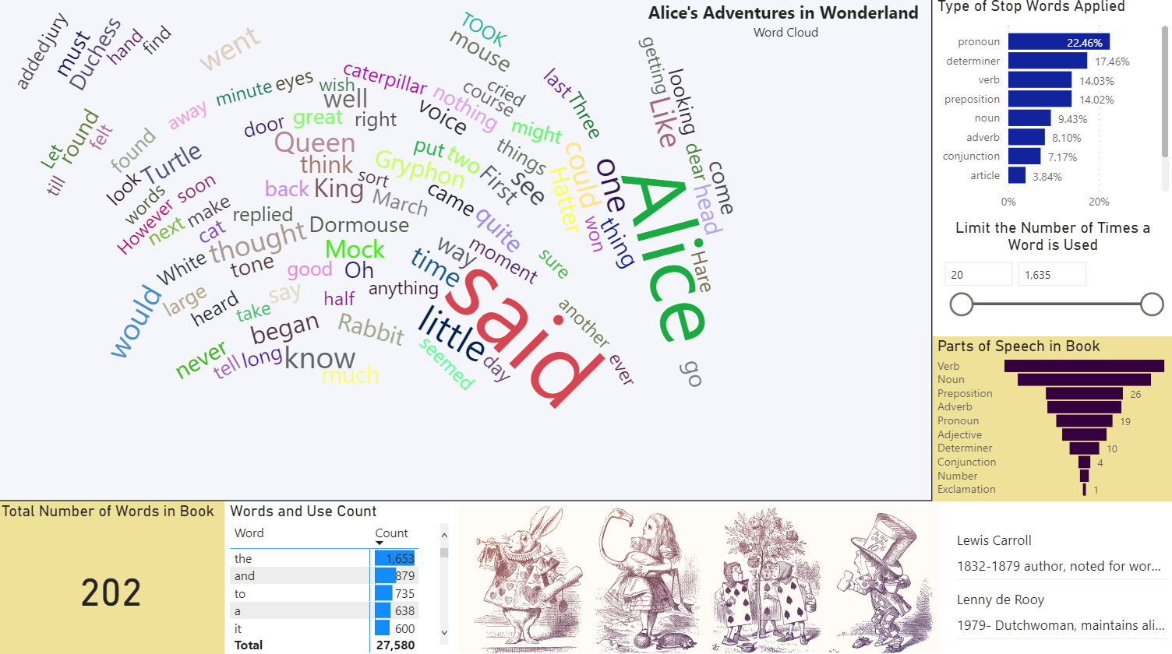
Build
Examine Stop Words
What types of words did Lewis utilize most?
Limit the number of times a word was used in the book

Slide 6
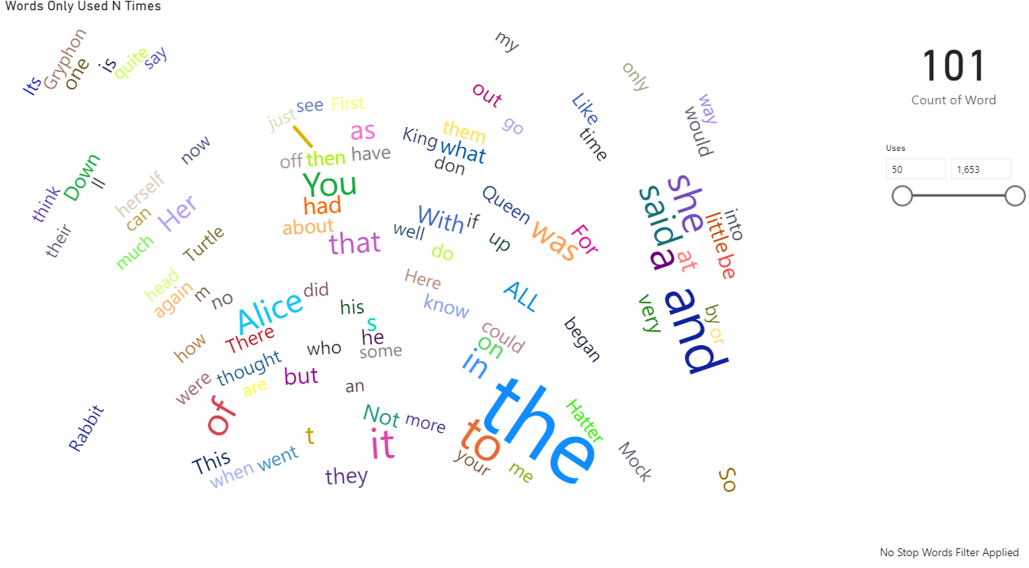
Observation
Although the author is known for word play, he shows most of his actions through single words, not used often, and usually during character speech.

Slide 7
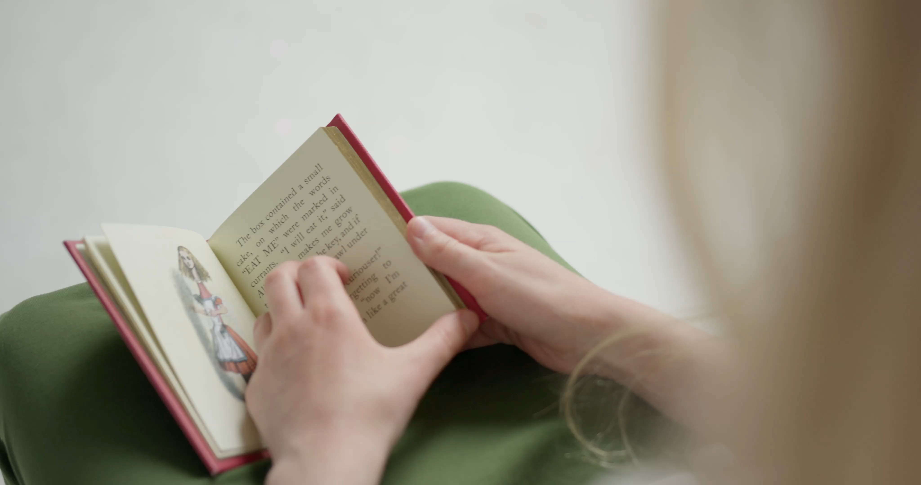
Thank you

